Slide 1
CSE5095-002: Topics in Software Defined Networking
Lecture 9
Minmei Wang
Computer Science and Engineering
Some slides are borrowed from the presentations of the original two papers listed in the next slide.

Slide 2
SDN and Virtualization
“Can the Production Network Be the Testbed?” (FlowVisor), OSDI, 2010
“Network Virtualization in Multi-tenant Datacenters,” NSDI 2014

Slide 3
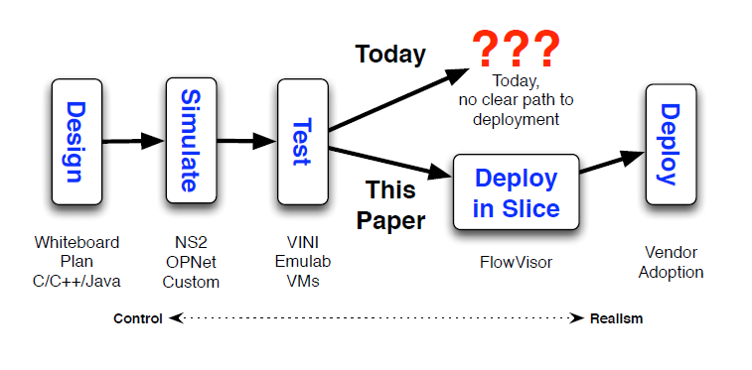
Motivation – efficient way to evaluate new research ideas
Can we build a testbed that is embedded into every switch and router of the production network?

Slide 4
FlowVisor
A way to build a testbed that is embedded in and grows with the network
Run on deployed hardware and at real line-rates
Software slicing layer
Allow real users to opt-in on a per-flow basis
Use a policy language to map flows to slices
Port easily to non-sliced networks
FlowVisor is transparent to both data and control planes
Enforce strong isolation between slices
Operate on deployed networks

Slide 5
FlowVisor Overview
App
App
App
App
App
App
Controller 1
Controller
2
Windows
(OS)
Linux
Mac
OS
Controller 1
Controller
2
Windows
(OS)
Linux
Mac
OS
Controller 1
Controller
2
Windows
(OS)
Linux
Mac
OS
Virtualization
Virtualization (FlowVisor)
x86
(Computer)
OpenFlow
Simple, common, stable, hardware substrate below
+ Programmability + Strong isolation model

Slide 6
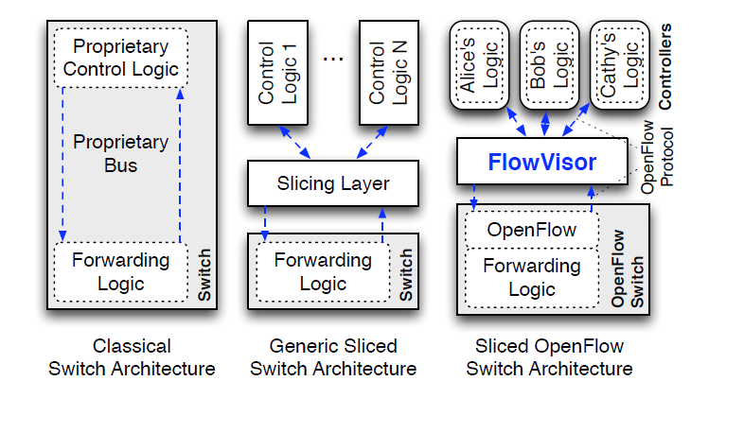
FlowVisor overview

Slide 7
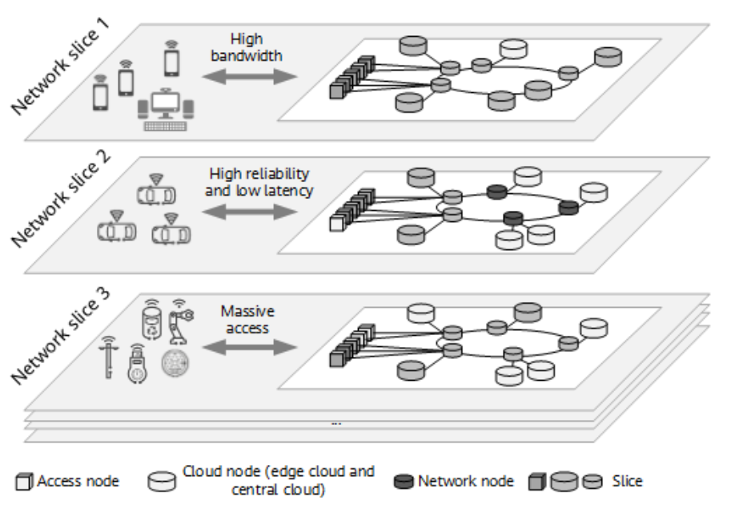
FlowVisor overview
Divide the production network into logical slices
Example of network slices

Slide 8
FlowVisor overview
Divide the production network into logical slices
Network resources are sliced
Topology, bandwidth, forwarding table entries, device CPU
Each slice has own distinct control logic
Each slice owner implements its control logic as an OpenFlow controller
Slices are defined using a slice definition policy language
Enforce strong isolation between slices
Actions in one slice do not affect another slice

Slide 9
Network slice and flowspace
A network slice controls a subset of traffic
The subset is defined by a collection of packet headers.
n-bit headers has n-dimension space – flowspace
Example:
HTTP traffic – TCP port = 80
All traffic from node 127.2.1.12 – IP_SRC=127.2.1.12
A subset of flowspace + a subset of topology + control logic = network slice

Slide 10
Properties of Flowspace
Backwards compatible
No end points need to change
Easily implemented in hardware
e.g., TCAM flow-table in each switch
Strong isolation of flows
Simple geometric construction
Can prove which flows can/cannot communicate

Slide 11
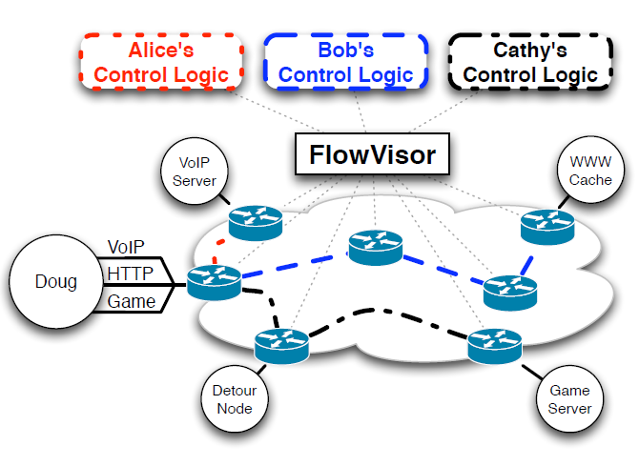
Slicing Example

Slide 12
Slicing Network Resources
Topology
Forwarding tables
Bandwidth
Device CPU

Slide 13
Slicing Network Resources
Topology
Each slice has its own view of network nodes and the connectivity between them
Forwarding tables
Each slice has a finite quota of forwarding rules
E.g., TCAM entries

Slide 14
Slicing Network Resources – Device CPU isolation
OF abstraction: process scheduling and rate-limiting
New flow messages sent to the controller
Use rate limit to control the new flow message arrival rate
Track, drop the packets if it exceeds some threshold
Controller requests
Throttle the OpenFlow message rate to a maximum rate per second for each slice
Slow-path forwarding
Rewrite to one-time packet forwarding events (then rate limit)
Internal bookkeeping (e.g., update internal counters)
Reserve sufficient CPU

Slide 15
Slicing Network Resources – bandwidth isolation
Create a per-slice queue on each port on the switch
Queue is configured for a fraction of link bandwidth
Sent out port X
Sent out queue Y on port X

Slide 16





FlowVisor Slicing Example
http
Load-balancer
Broadcast
Multicast
OpenFlow
Protocol
OpenFlow
Switch
FlowVisor
OpenFlow
Protocol
OpenFlow
Switch
OpenFlow
Switch

Slide 17
FlowVisor Slicing Example (Cont’d)
LTE-WiFi
Handover
Tricast Lossless
Handover
Learning
switch
Mobile VMs
New BGP
Bob’s
FlowVisor
Alices’s
FlowVisor
GENI’s
FlowVisor
Production
Network
Controller
OpenFlow Protocol
Network Administrator’s
FlowVisor
OpenFlow Protocol
OpenFlow
Switch
OpenFlow
Switch
OpenFlow
Switch
Hierarchical slicing

Slide 18
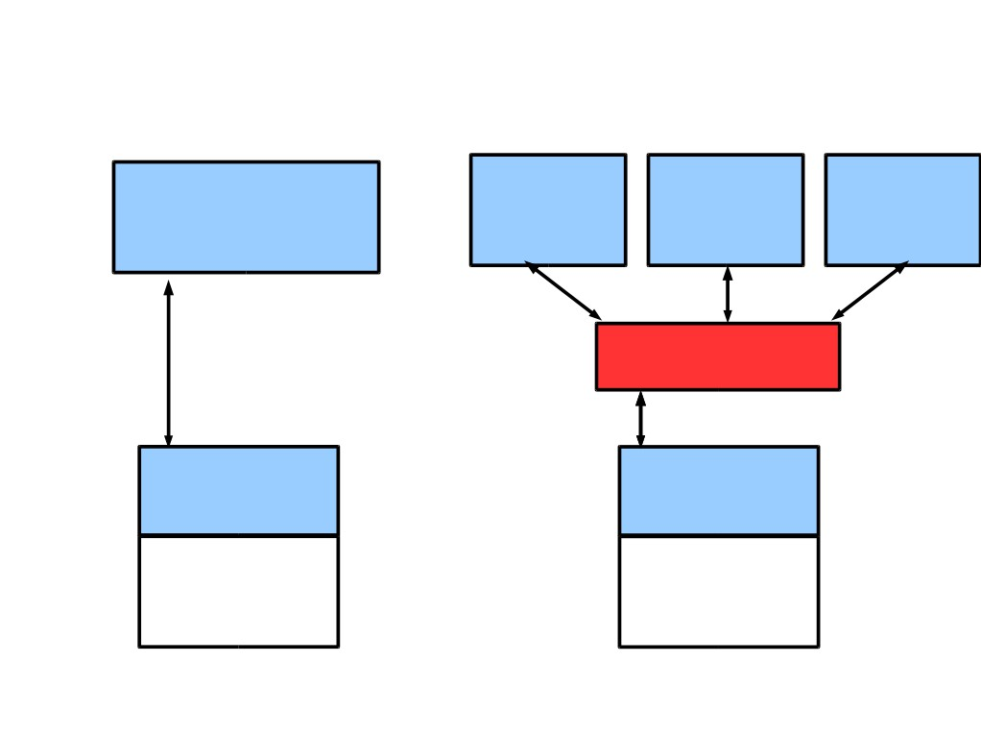
FlowVisor Implemented on OpenFlow
Server
Servers
Custom
OpenFlow OpenFlow OpenFlow
Control
OpenFlow Controller
Plane
Controller Controller Controller
OpenFlow
Network
OpenFlow
FlowVisor
Protocol
Stub
OpenFlow
Control
OpenFlow
OpenFlow
Plane
Firmware
Firmware
Data
Plane
Data Path
Data Path
Switch/
Switch/
Router
Router

Slide 19
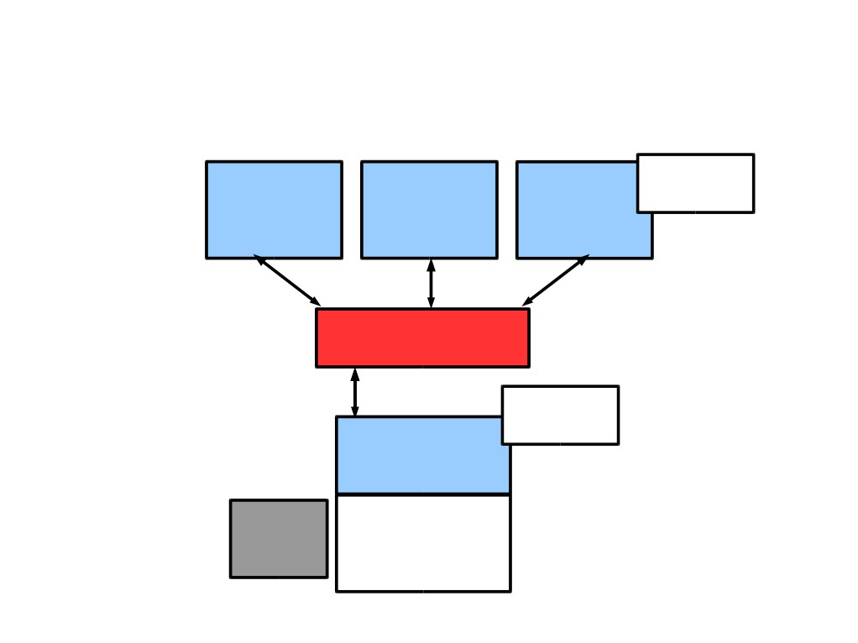
FlowVisor Message Handling
Alice Bob
Rule
Cathy
Controller Controller
Controller
OpenFlow
Policy Check:
Policy Check:
Is this rule allowed?
FlowVisor
Who controls this packet?
OpenFlow
Full Line Rate Forwarding
Exception
OpenFlow
Firmware
Packet
Data Path
Source: R. Sherwood

Slide 20
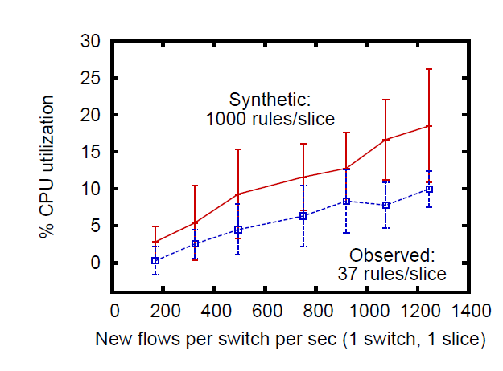
Evaluation
Scalability
Linear growth with new flow rate

Slide 21
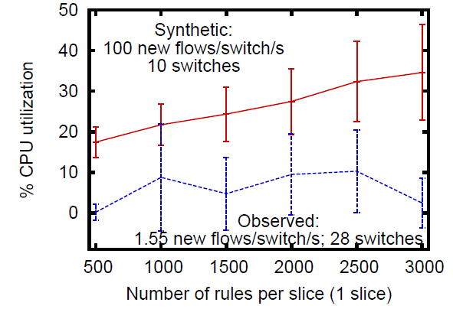
Evaluation
Scalability
Linear growth with number of rule per-slide
Fluctuation with observed workload

Slide 22
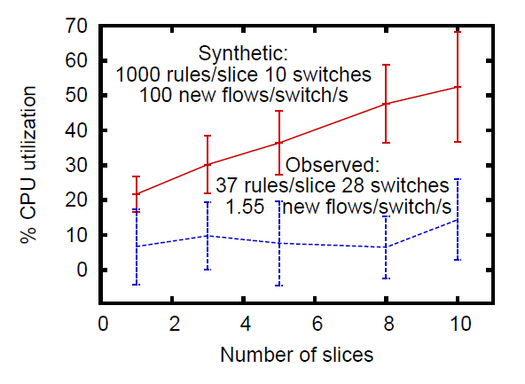
Evaluation
Scalability
Linear growth with number of slices
Fluctuation with observed workload

Slide 23
Conclusion
• Network slicing can help perform more realistic evaluations and support multiple tenants
• FlowVisor allows experiments to run concurrently but safely on the production network
• Currently limited to subsets of actual topology
- Add virtual links, nodes support

Slide 24
SDN and Virtualization
“Can the Production Network Be the Testbed?” (FlowVisor), OSDI, 2010
“Network Virtualization in Multi-tenant Datacenters,” NSDI 2014

Slide 25


NETWORK VIRTUALIZATION?
Network Elements
VLAN NAT MPLS VRF as VMs FlowVisor
~1985
1993 1995+
Late 1990s
~2005
2010
VLAN | NAT | MPLS | VRF | Elements as VMs | FlowVisor
Subnet | IP address space | Path | L3 FIB | Elements | ASIC
Plenty of primitives but no network virtualization per se.

Slide 26


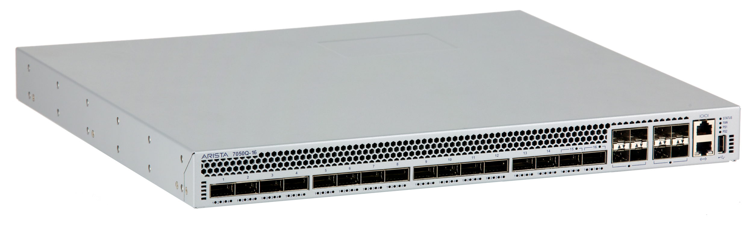
MULTI-TENANT DATACENTERS
Compute Virtualization Layer
Result with the aforementioned primitives:
Slow provisioning • Mobility is limited
Limited VM placement • Hardware dependent
Operationally intensive
…

Slide 27


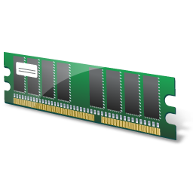
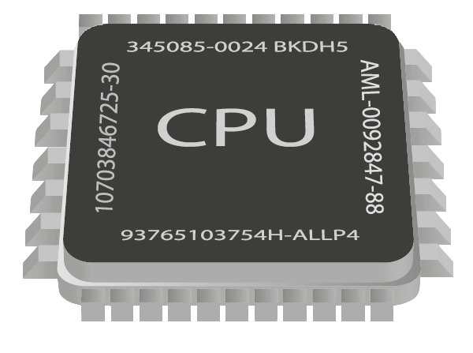
NETWORK HYPERVISOR
Workload
Workload
Workload
Workload
Workload
Workload
Workload
App
App
App
App
App
App
App
x86
L2, L3, L4-L7 Services
VMs
Server Hypervisor
Logical Networks
Network Hypervisor
Decoupled
Standard x86
Standard IP connectivity

Slide 28
AGENDA
Overall design of NVP network hypervisor.
Design challenges.
Hard lessons learnt.

Slide 29





WHAT IS A NETWORK HYPERVISOR?
Packet Abstraction
Mgmt Mgmt Mgmt
Logical Network
Logical Network
Network Hypervisor
Logical Network
Control Abstraction
Packet Abstraction + Control Abstraction = Network Hypervisor

Slide 30
WHAT ARE THE ABSTRACTIONS?
Control abstraction
Allow tenants to define a set of logical network elements that they can configure
Networking has no single high level control interface
There is a low-level one
Packet abstraction
Compliance with standard TCP/IP stack is a necessity:
L2, L3 semantics (unicast, ARP, …)
Tenant’s Control Plane
Logical Datapath
Packet In
ACL
L2
L3
ACL
Packet Out

Slide 31










GENERALITY OF DATAPATH
Switch CP Router CP Switch CP
Datapath Datapath Datapath
ACL
L2
ACL
ACL
L2
L3
ACL
ACL
L2
ACL
2-tier logical topology
Arbitrary logical topology
One logical switch
Faithful reproduction of physical network service model.

Slide 32






WHERE TO IMPLEMENT?
Tenant CP
Network Hypervisor
•
Independence from physical hardware.
Programmatic control. Operational model of compute virtualization.
Network Core
•
•
No extra x86 hops: just the source and destination hypervisor!

Slide 33
WHAT IS A NETWORK HYPERVISOR?
Packet Abstraction
Mgmt Mgmt Mgmt
Logical Network
Logical Network
Network Hypervisor
Logical Network
Control Abstraction
Packet Abstraction + Control Abstraction = Network Hypervisor

Slide 34
INSIDE THE VIRTUAL SWITCH
Datapath
Datapath
Datapath
ACL
L2
ACL
ACL
L2
L3
ACL
ACL
L2
ACL
Logical Topology First-hop vSwitch
OF
OF
OF
OF
OF
OF
OF
OF
OF
OF
OF
OF
OF
OF
Send to tunnel
3rd logical datapath
Determine the next…
2nd logical datapath
Determine the next logical datapath
Execute 1st logical datapath
Identify logical ingress port

Slide 35




COMPUTATIONAL CHALLENGE
Controllers learn the location of VMs.
Controllers proactively compute & push all forwarding state required to connect each VM.
Forwarding State = F(configuration,VM locations)
Repeat above as logical configuration or physical configuration (VM placement) changes.
Challenge: How to compute O(N²) volume of low-level OpenFlow and OVSDB state, when inputs change all the time.

Slide 36
STATE COMPUTATION
Forwarding State = F(configuration, VM locations)
1. How to Scale Computation
2. How to Guarantee Correctness
Incremental computation and pushing for quick updates.
Avoid all handwritten finite state machines, machine generated instead.
Datalog based declarative language to program F.
Shard the computation across controller cluster.

Slide 37
LESSONS LEARNT: ABSTRACTIONS
“Basic Enterprise App”
“Modern App”
“Bank”
A logical switch
Two tier logical network
Arbitrary logical network
Assumptions about logical network structure often embedded into the workload.
A single L2 domain sufficient for initial, simple workloads.
To support more complex workloads without changing them, more complex logical topologies become a necessity.

Slide 38














LESSONS: FAILURE ISOLATION
Batch N
OpenFlow
OVSDB
Custom Protocol
Batch 2
Batch 1
Two Channels, No Atomic Updates
One Channel, Atomic Updates
Proactive pushing of all state not enough to decouple controllers from data plane.
Atomically applied, batched updates.
Connection failure does not result in incomplete state.
Connection may die while pushing updates.
Data plane may operate over incomplete state!
At most old state.

Slide 39
LESSONS: SCALING
OPENFLOW IS EXPENSIVE
Too primitive
Too tightly coupled
Simple operations take several flow entries.
Each switch requires some flow customization; can’t just blindly replicate flows.
For example, tunnel failover, encapsulation header ops.
To compute flow entries, may have to wait for responses from the OVS configuration database.
Lots of redundancy.
Replace a OF & OVSDB with a network virtualization specific protocol.
OpenFlow becomes a protocol internal to the hypervisor.

Slide 40
Conclusion
Openflow can facilitate network virtualization
The current practice of network virtualization is not ideal. This paper presents a limited form of network virtualization for special cases.

